Slide 1




ML2425-09 Semantic Similarity Analysis
of Textual Data
Presented by
Embedders
Professors: Damir Dobric / Andreas Pech
Course: Software Engineering
Muhammad Haris Mahmood (1502783)
Ali Raza (1567278)
Hong Huynh (1565526)

Slide 2



Introduction
This research introduces a generalized model for semantic similarity analysis using:
Cosine Similarity
PCA & t-SNE for dimensionality reduction
Retrieval-Augmented Generation (RAG) for enhanced retrieval
Adapts to various domains using the PESTLE framework.
Visualizations like 2D graphs & scatter plots illustrate comparisons between words, PDFs, and datasets, showcasing real-world applications.

Slide 3
What is Semantic Similarity?
Understanding semantic similarity in textual data is crucial in natural language processing (NLP).
It measures how closely the meanings of words, phrases, or documents relate to each other.
Various techniques, including cosine similarity, have been used to measure these relationships.
Embedding Models
Open AI’s text-embedding-ada-002
Open AI’s text-embedding-3-small
Google’s Word2Vec

Slide 4
Cosine Similarity
Measures the similarity of words, phrases, and documents in a high-dimensional embedding space.
Word embeddings are generated using pre-trained language models, and their similarity is calculated through cosine similarity.
Principle: Cosine similarity measures the angle between two vector embeddings. A smaller angle means higher similarity.

Slide 5
Visualization Techniques
2D graphs
Cosine similarity table
Scatter plot (Dimensionality Reduction technique)
RAG pipeline

Slide 6
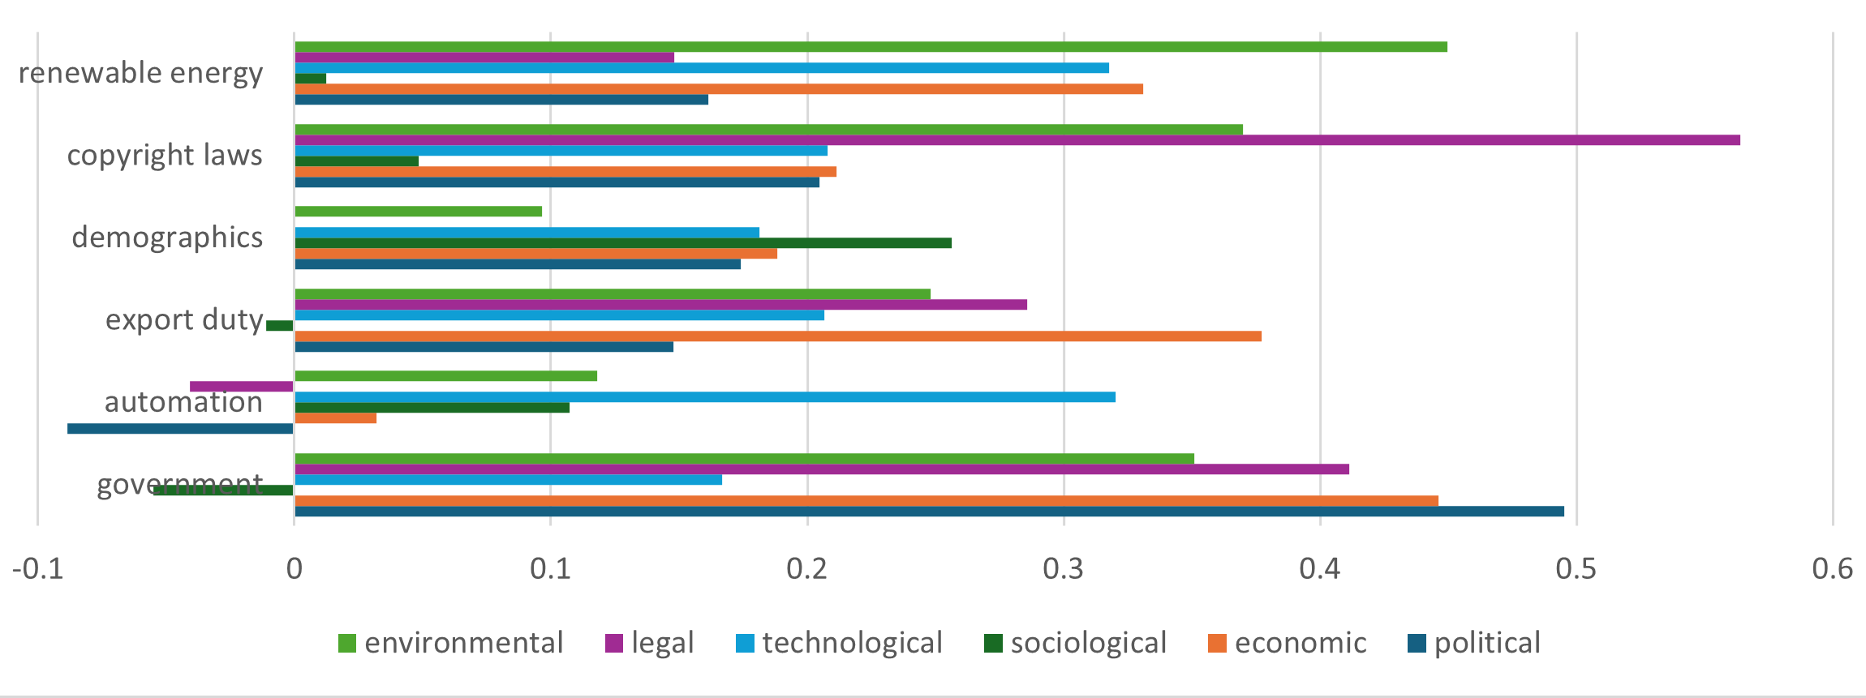
PESTLE vs Words
(word2vec)

Slide 7
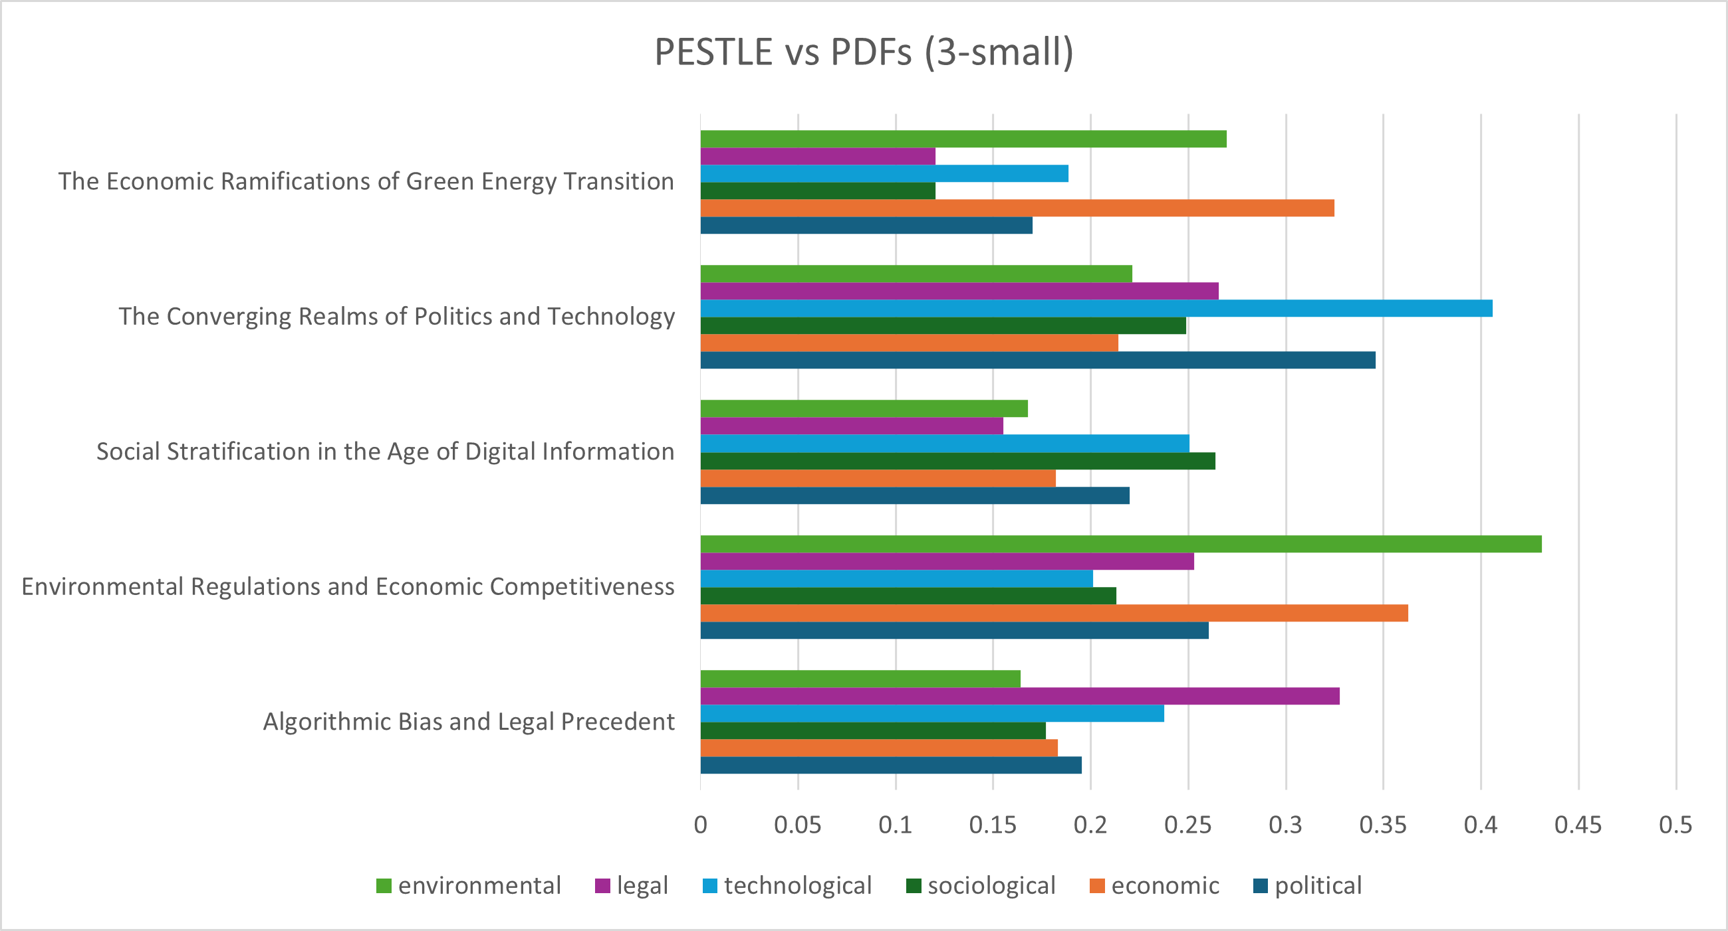
PESTLE vs PDFs
(3-small)

Slide 8
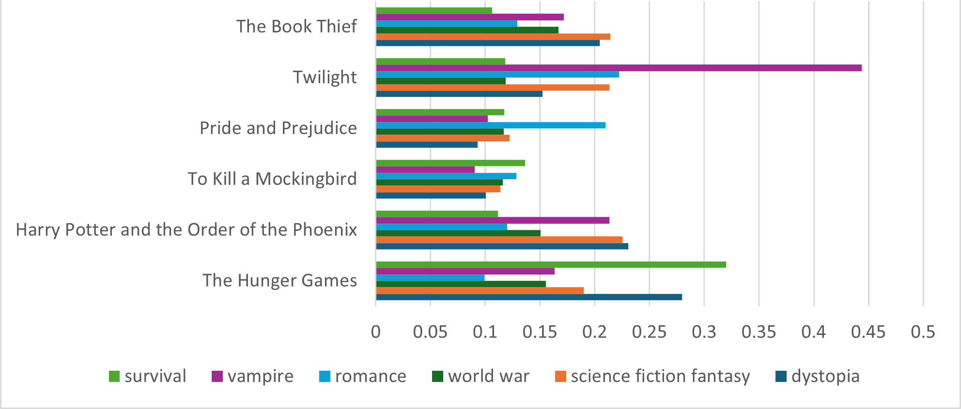
Words vs Datasets
(3-small)

Slide 9
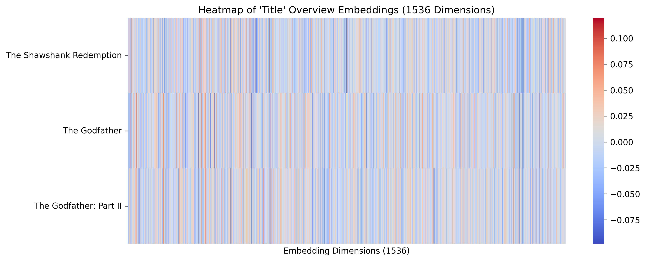
Heat Map of Title Embeddings
(1536 Dimensions)

Slide 10
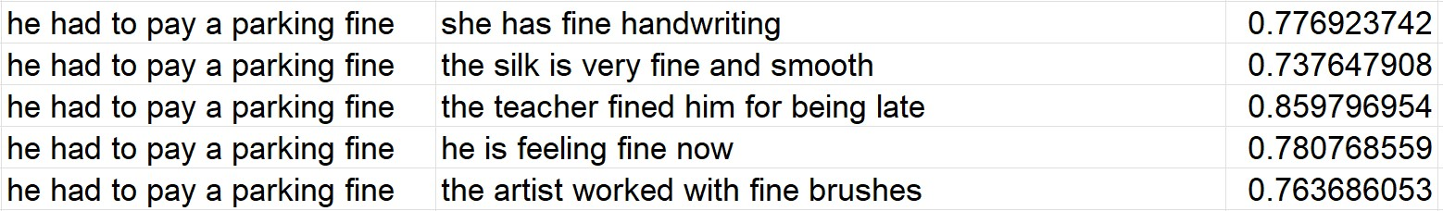
Phrases vs Phrases
(text-embedding-ada-002)

Slide 11



Dimensionality Reduction for
PCA
Retains the most significant variance in the data.
01
02
t-SNE
Focuses on preserving local relationships between data points.
Visualization
Word embeddings typically have 1536 dimensions, making direct visualization difficult.
⇨ To address this, we employ Principal Component Analysis (PCA) and t-Distributed Stochastic Neighbor Embedding (t-SNE) to reduce dimensionality to two dimensions.
03

Slide 12
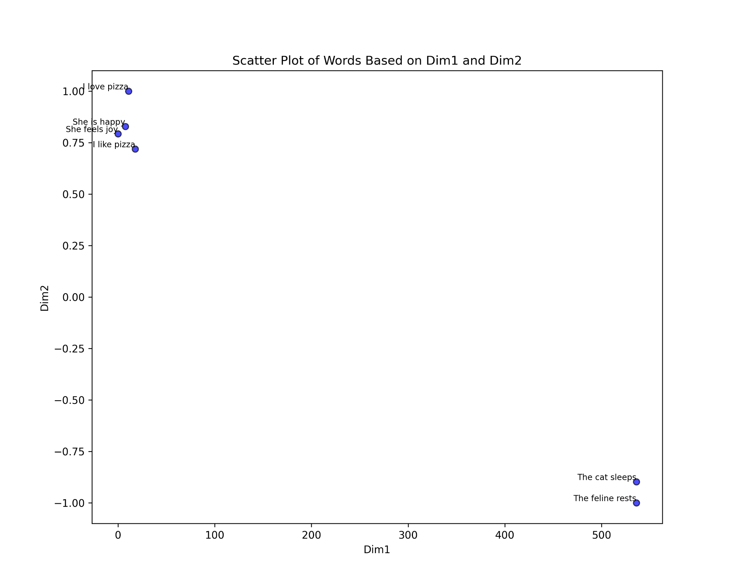
Dimensionality Reduction
Open AI t-SNE Scatterplot

Slide 13
Retrieval-Augmented Generation (RAG)
01
01
Query Retrieval
The system retrieves the top-k relevant.
02
LLM Generation
A large language model generates responses.

Slide 14
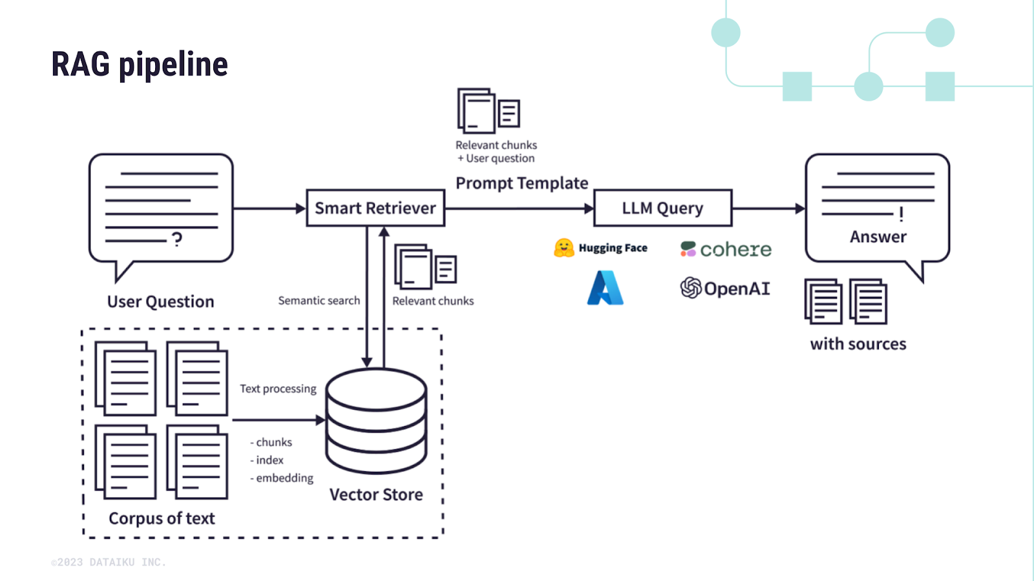
RAG Architecture Diagram

Slide 15
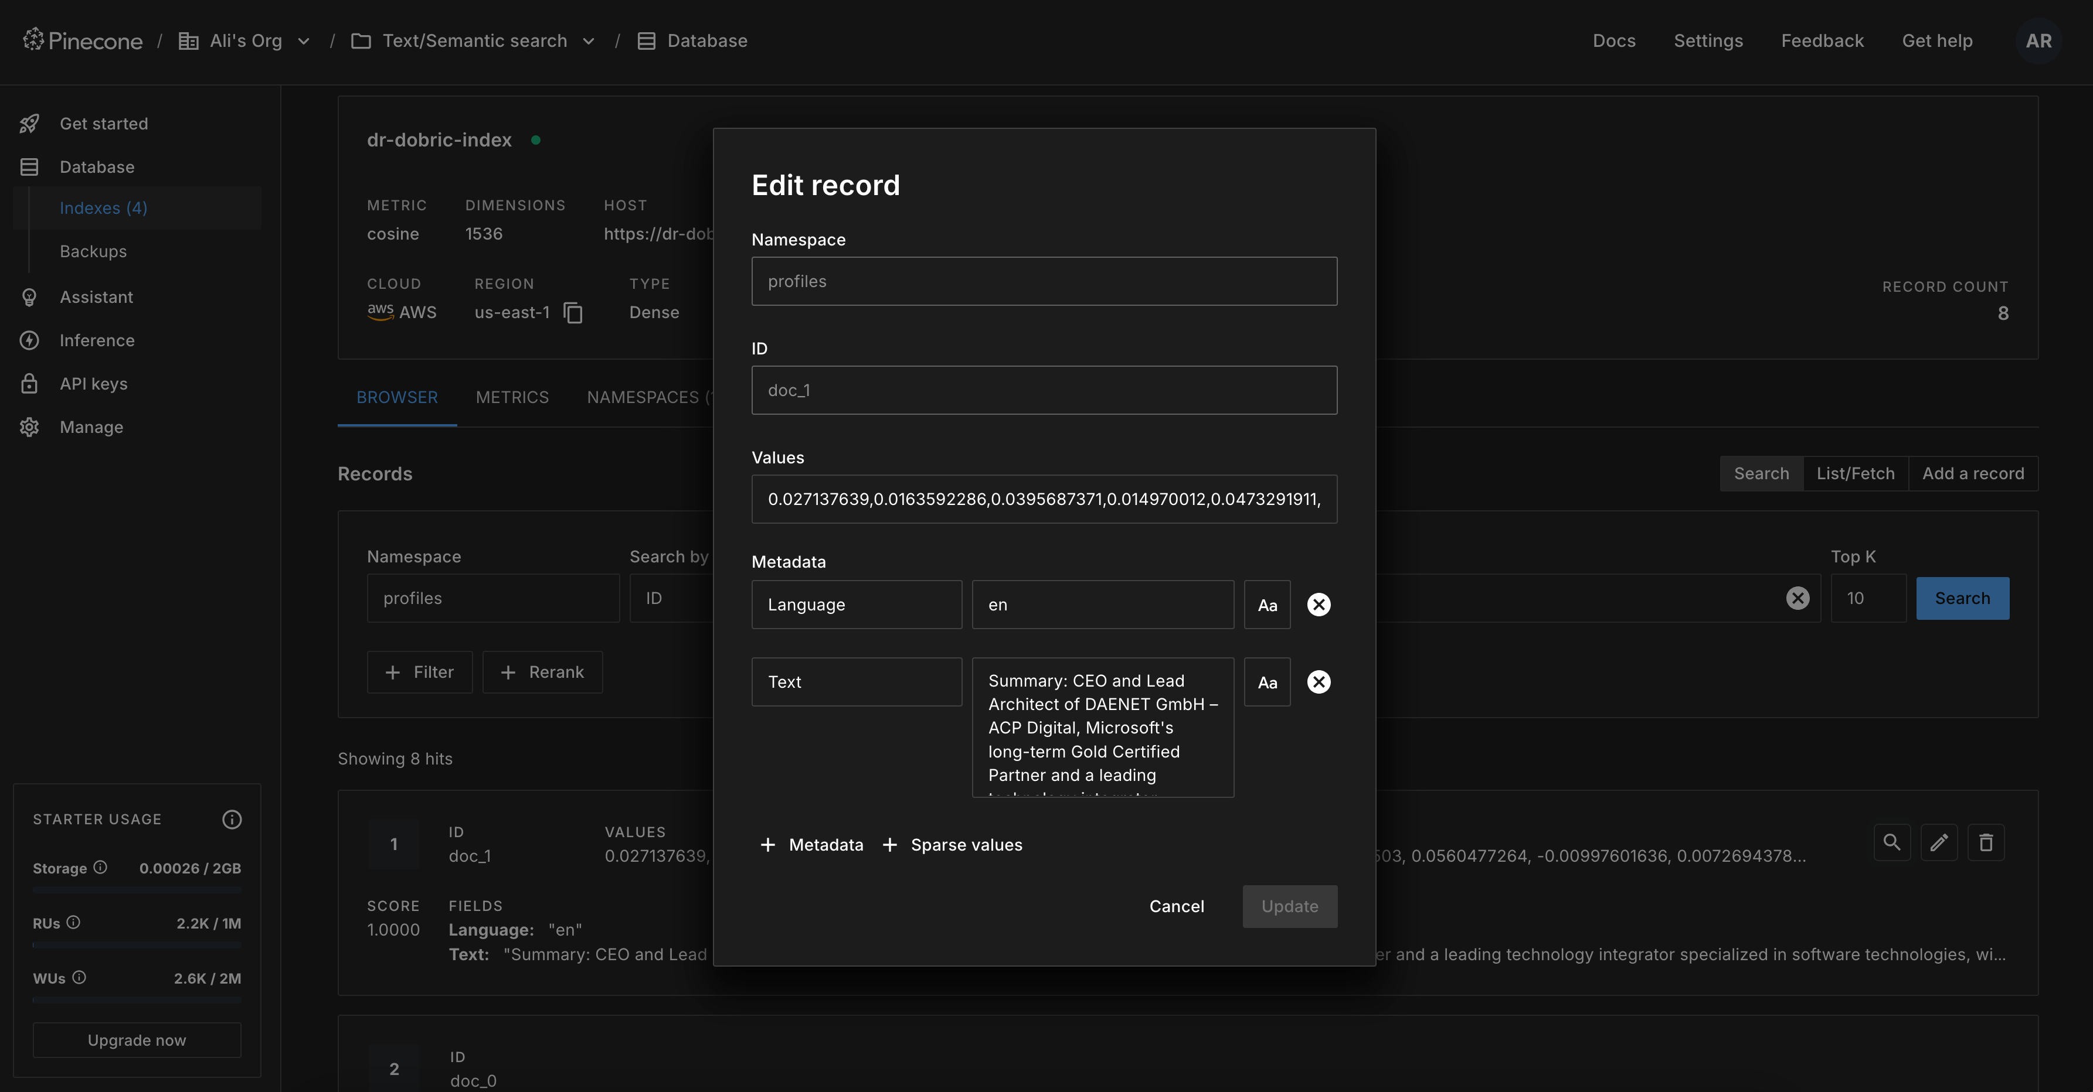
Pinecone Vector Database

Slide 16
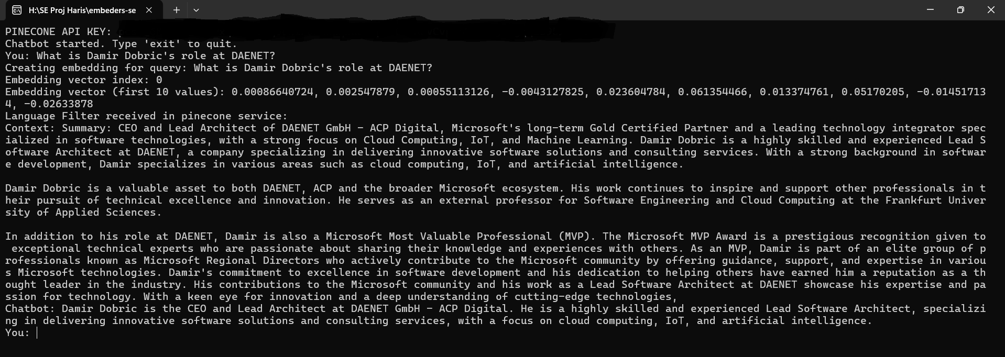
Chatbot

Slide 17
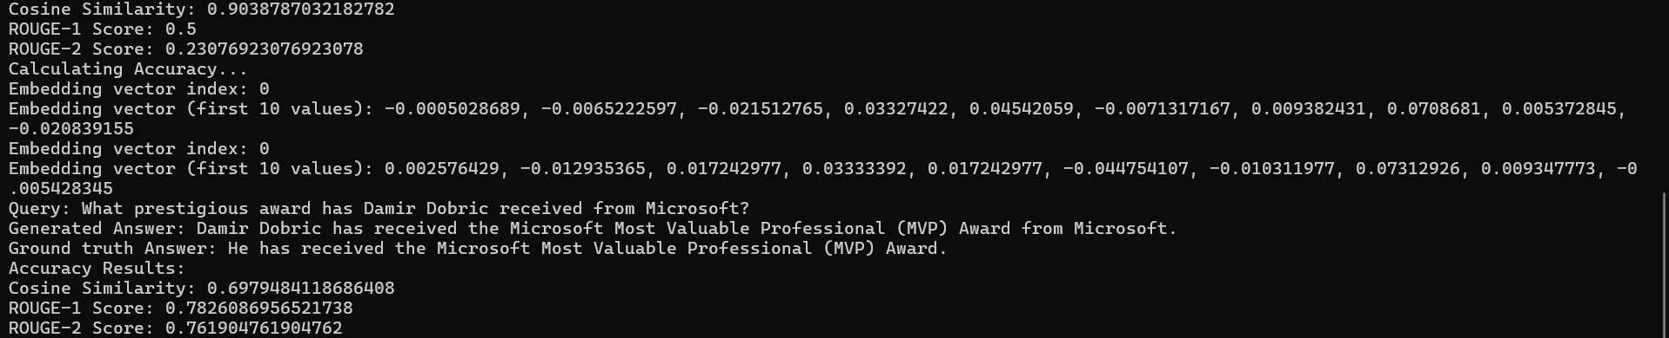
RAG Accuracy Calculator
Low Cosine Similarity yet high ROUGE values

Slide 18

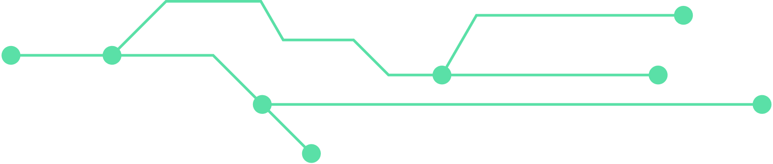
Multilingual Model
mRAG
Global Datasets
The model supports multiple languages useful for multilingual customer support and cross-language searches

Slide 19
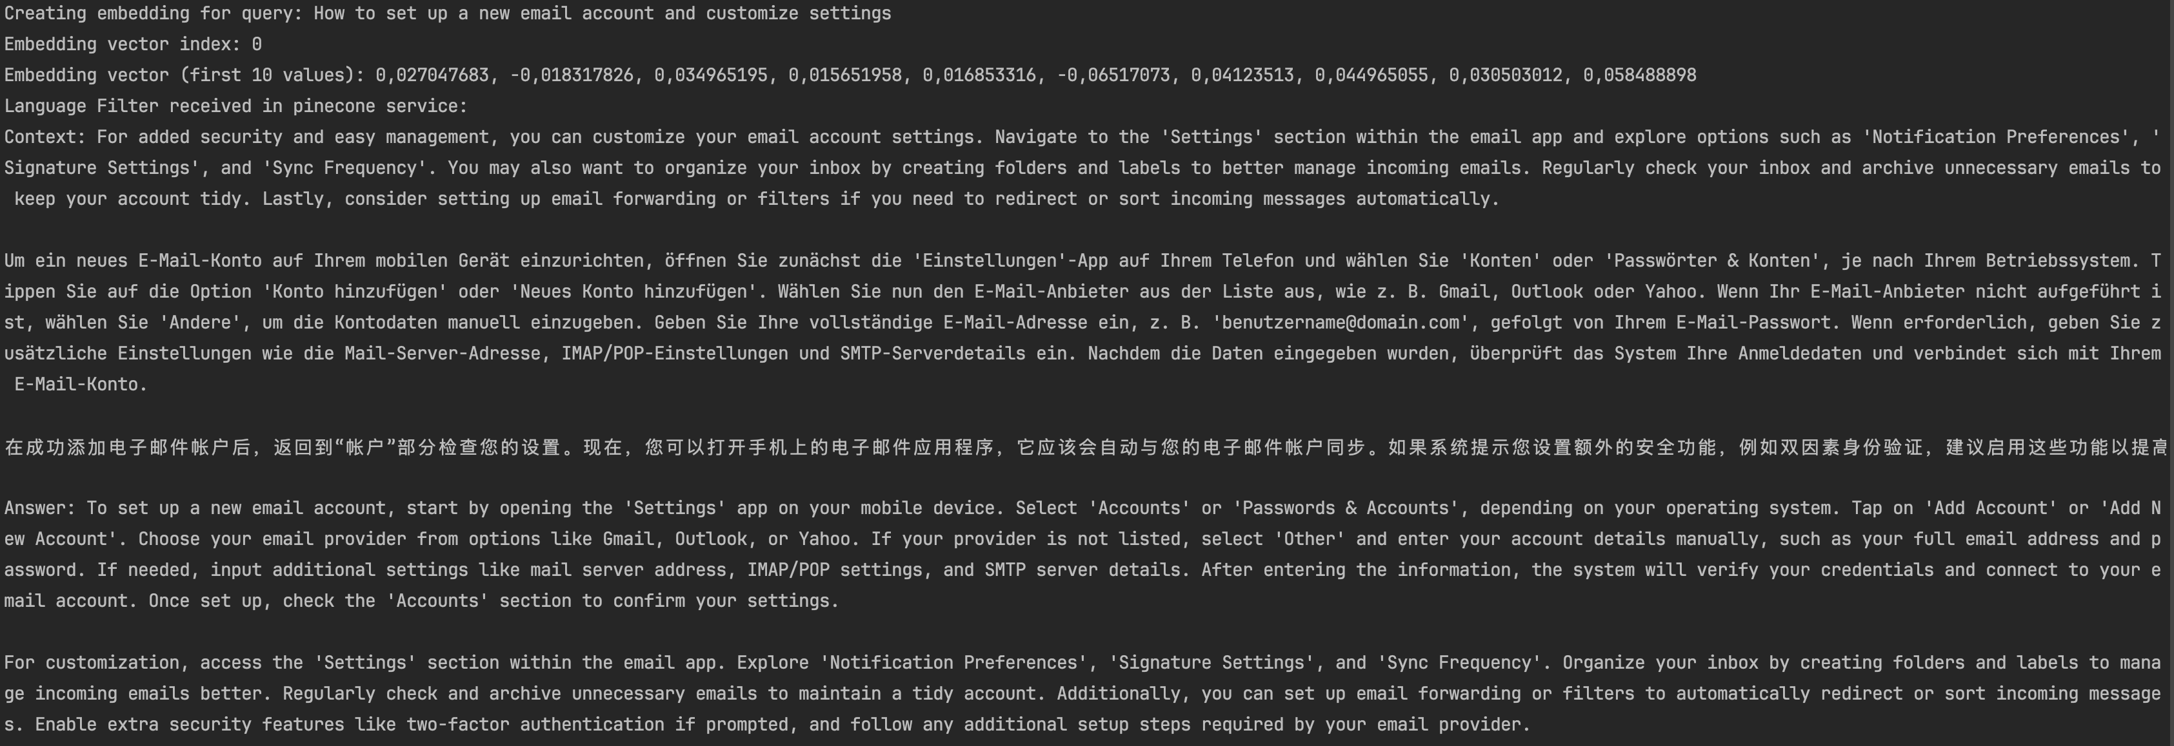
Multilingual Model
mRAG

Slide 20
Conclusion
Project Highlights
Semantic similarity through cosine similarity
Visualization: 2D graph, scatter plot, cosine similarity table, output screens
RAG pipeline with Pinecone for storage & retrieval
RAG accuracy validation: Cosine similarity & ROUGE scores
Supports chatbots, multilingual analysis (mRAG)
02
03
04

Slide 21

Limitations
& Future Work
Needs better efficiency in handling complex reasoning queries.
Need to improve prompt engineering for language consistency.
Integrate .NET-Python for all types of graph plotting.
Use RAG for advanced recommendation systems instead of 2-D graphs.

